Slide 1
Electronic Management Guidelines
Secretary of State
Jeanette Greer
Records Management Division Manager
402-471-2747

Slide 2
Records Definitions
“Record means any book, document, paper, photograph, microfilm, sound recording, magnetic storage medium, optical storage medium, or other material regardless of physical form or characteristics created or received pursuant to law, charter, or ordinance or in connection with any other activity relating to or having an effect upon the transaction of public business.”
                §84-1202(4)

Slide 3
Electronic Records
The general principles of records management apply to records in any format. Electronic records, however, raise specific issues. It is more difficult to ensure that the content, context, and structure of records is preserved and protected when the records do not have a physical presence. This has important implications for the authenticity, reliability, and trustworthiness of records.
-Wikepedia

Slide 4
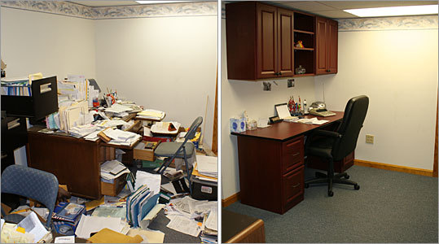
Cluttered Records Retention

Slide 5
Electronic Records
Electronic records that meet the definition of a record under the Records Management Act are official records and must be retained according to state and federal retention schedules.
Transmitting records electronically does not alter the obligation to retain these records nor does it alter corresponding retention periods. The content of the electronic record must be evaluated to determine the length of time to retain the message.

Slide 6
Managing Electronic Records
Electronic Records must be classified, stored, and disposed of consistent with business, legal, historical, and financial requirements.
Guidelines for Records Retention are available on the Secretary of State’s website using schedule 124 – General Records for State Agencies or your individual agencies Retention Schedule.

Slide 7
Email Management
Retention IS based on the content of the message.
Is NOT saving all email forever.
Is NOT setting arbitrary time limits for all messages.
Is NOT managing based on mailbox size.
Is NOT declaring “email” a records series.
Is NOT a “do-nothing” strategy.

Slide 8
Outlook/Exchange 2010
The Microsoft Outlook/Exchange 2010 system has default retention policies/tags.
Email users are to use these retention guidelines to manage the records retention requirement for email exchanges. Retention must be followed not only for the inbox but also with the sent messages box.
Instant message and voice mails may be emailed to the inbox and the retention guidelines may be used to handle these electronic messages as well.
Training is available on the Employment Development Website with Lynda.com for Outlook 2010

Slide 9
MS Outlook/Exchange 2010
RM Information
Microsoft Outlook 2010 allows users to:
  Manage email by applying retention policies to folders and/or individual email
  Allows flexibility in development of personal folder organization/structure

Slide 10
Microsoft Outlook 2010
Default Retention Policies can be set up in email folders
Automated email disposal based on retention and system cycling process can be set up.
Manual management for some email is allowed.
Parent folders with assigned Retention determine disposition for sub folders and email unless:
  Sub folder is given a different retention policy or an individual email is tagged with a different email retention policy.

Slide 11

Folder Retention Policies
Assign a retention policy to folders:
  In the Navigation Pane, click on a mail folder.
  On the folder tab, in the Properties group, click Policy.
  On the Policy tab, in the Folder Policy list, click an entry based on your agency’s retention schedule.

Slide 12

Individual Email Retention
Assign a retention policy to email messages:
  In the message list, click on a message.
  On the pop up menu, select Assign Policy.
  Under Retention Policy, click on an entry based on your agency’s retention schedule.

Slide 13
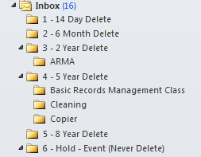
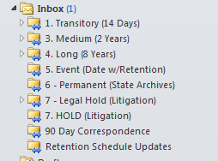
Retention Folders may be set to
Agency Specifications

Slide 14
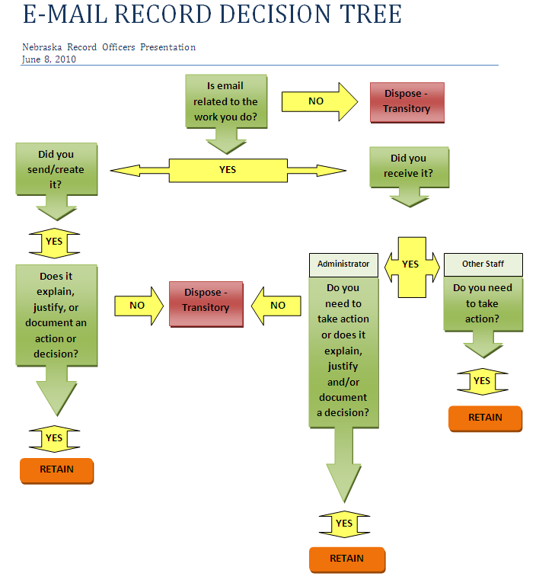

Slide 15

NEBRASKA STATE HISTORICAL SOCIETY COMMUNICATIONS/CORRESPONDENCE GUIDELINES FOR NEBRASKA STATE RECORDS
 | Agency Head/CEO/Elected Official/Commission Chair | Administrator/Deputy Administrator | Managerial & Professional/Specialist Staff | General & Support Staff
SHORT-TERM (EPHEMERAL) | None | None | None | None
MEDIUM-TERM | Subject to Review by State Archives for Possible Accession. | None | None | None
LONG-TERM | State Archives | Subject to Review by the State Archives for Possible Accession. | None | None
PROJECT-RELATED | Subject to Review by State Archives for Possible Accession. | Subject to Review by the State Archives for Possible Accession. | None | None
Instructions for using this guide:
1) The 'grey' highlighted fields represent communications that should be sent to the State Archives or is subject to State Archives review once they have met the retention requirements on approved retention schedules. Contact the State Archives to negotiate the transfer.
2) Any communications that will not be accessioned by the State Archives may be disposed of once the retention requirements have been met based on approved retention schedules.
Contact the State Archives with questions related to using this guide:
Gayla Koerting, Curator of Government Records
NE State Historical Society
Phone: 402-471-4783
Email: gayla.koerting@nebraska.gov

Slide 16
Roundtable Discussion on Records
List Serv
Contract Negotiations
Electronic Magazines
Vacation/Sick Request or Leave
Disciplinary Actions
Executive Director Emails

Slide 17
Suggestions for Management of Email Folder
If you set up folders on emails to use a default retention schedule you may then:
Weekly-
  Empty Deleted Items Folder
  Check Junk Email Folder
  Review Sent Items Folder

Slide 18
Suggestions for Management of Email Folder
Monthly-
Review Long or 8 year folder for review by State Archives.
Transfer of electronic records to State Archives is requested by security (Gold) CD.

Slide 19
Questions??
Comments?
Suggestions?

